Slide 1
TTC - Mestrado em Microbiologia APLICADA
IE - MESTRADO EM MATEMÁTICA APLICADA ECONOMIA & GESTÃO
ITT – Engenharia Biomédica e Biofísica
IE/EMP - OPCIONAL PARA 2º CICLO/3º CiCLO
AULA 1
18 Fev 2019
FCUL – 2018/2019
Helena Vieira
Copyright ©

Slide 2
Programa (1)
18/FEV- Apresentação da disciplina. Expectativas e Objectivos. Métodos de avaliação ao longo do semestre. O Método de Alex Osterwalder – Business Model Canvas. K2BTEAMS – learn by doing. Escolha dos projectos K2B e grupos de trabalho.
11/MAR- Emprego versus negócio. Empreendedorismo versus Inovação/TTC. A valorização económica do conhecimento técnico-científico. A indústria versus a Universidade. Conceitos e definições base. Ferramentas de gestão e técnico-científicas. Soft skills e vantagem no mercado actual.
18/MAR-Inovação e o processo de desenvolvimento de novos produtos. O processo from bench to market. Alex Osterwalder e o Business Model Canvas – o Método e as diferentes parcelas. O Cliente, o Utilizador e o Influenciador. A Competição.
25/MAR- BM canvas: A Proposta de valor. Conceito de valor na exploração/comercialização de novos produtos. Avaliação da atractividade de oportunidades de negócio. Protecção da propriedade intelectual/patentes.

Slide 3
Programa (2)
01/ABR – SEMINÁRIO/Caso de Estudo: FreshTEC: Revolutionizing Fresh Produce. Apresentação, debate e conclusão*
08/ABR - BM Canvas: Os Canais e Relações. Comunicação com o cliente. Principais métodos. Marketing Mix. Análise de Mercado. Mercado e nicho de mercado. Análise da Indústria. Análise SWOT: apresentação do conceito e casos de estudo. Debate sobre uma SWOT de um negócio actual.
15/ABR-1ª Apresentação das propostas de valor das K2BTeams. (10 min).
29/ABR- Visão e Missão. Plano de acção: objectivos – pressupostos – milestones. BM Canvas: Capacidades e competências. Actividades e Recursos Chave. Parcerias. Trabalho no 2º Draft do BM Canvas.

Slide 4
Programa (3)
06/MAI- BM Canvas: Principais fontes de Custos. Fontes de receita. Projecções financeiras. Risco versus benefícios. Fontes de capital: 3Fs, business angels, capital de risco, banca. O Plano de negócios – decisão final. Pitching. A arte de “convencer”.
13/MAI- 2ª apresentação K2B: Estratégia from bench-to-market das K2BTeams (10 min)
20/MAI- A capacidade de vender um sonho: Pitch individual sobre tema à escolha (2 min). (25/Nov)
27/MAI- Pitch final das K2BTEAMS (5 min). EXECUTIVE SUMMARY & BM Canvas Final. Conclusões e encerramento da disciplina.

Slide 5
HOW WILL WE TEACH YOU?
LEARNING BY DOING Methodology
Story Telling & Inspirational Teaching
Challenges & Gamification (yep, competition will occur!)
YOU = MINI ENTREPRENEURIAL IMMERSIVE EXPERIENCE (K2B)

Slide 6
BOOKS YOU SHOULD CHECK
Clark, T., Osterwalder, A. e Pigneur, Y (2009), “Business Model Generation”. Self Published. ISBN:978 2 8399 0580 0.
Osterwalder, A., et al. (2014), “Value Proposition Design”
Clark, T., Osterwalder, A. e Pigneur, Y (2012), “Business Model You”
Steve Blank. (2013). The four steps to Epiphany. Self Published. ISBN: 0 989 200 507.
Eric Ries. (2011). The Lean Startup: How Today's Entrepreneurs Use Continuous Innovation to Create Radically Successful Businesses. Crown Business, USA. ISBN 978-0-307-88789-4.
Biodesign Website: http://www.stanford.edu/group/biodesign/cgi-bin/ebiodesign/
Ambrose, G. e Harris, P. (2009), “Basics Design 08: Design Thinking”, AVA Publishing SA
Blank, S. e Dorf, Bob (2012), “The Startup Owner’s Manual: The Step-By-Step Guide for Building a Great Company”, K & S Ranch
Campinos, A., et al. (2010), "Código da Propriedade Industrial - Anotado", Almedina
Entrepreneurship Monitor – GEM Portugal 2014
Ernest & Young (2011), “Nature or nurture DNA”
Glei, Jocelyn K. (2014), “Make your Mark: The Creative’s guide to building a business with impact”, Amazon Publishing
Hoffman, R. e Casnocha, B. (2012), “The startup of you: Adapt to the Future, Invest in Yourself, and Transform your Career”, The Alliance
Kawasaki, G. (2004) “The Art of the Start: The Time-Tested, Battle-Hardened Guide for Anyone Starting Anything”
Kelley, T., Littman, J. e Peters, T. (2001), “The Art of Innovation - Lessons in Creativity from IDEO, America's Leading Design Firm”, Profile Business
Mota, A., e Custódio, C. (2006), “Finanças das Empresas”, Booknomics
Rede ETC - Universidade de Lisboa (2014), "Princípios Gerais e Carta de Boas Práticas"
Regulamento de Propriedade Intelectual da Universidade de Lisboa
Rocha, M. e Carreiro, H. (2005), "Guia da Lei do Direito de Autor na Sociedade da Informação", Centro Atlântico
Smith, J. e R. Smith (2004, 2ª Ed.), “Entrepreneurial Finance”, Willey
Summers, J. E Smith, B. (2009), “Communication Skills Handbook”, John Willey & Sons Ltd
Timmons, J., A. Zacharakis e S. Spinelli (2004), “Business Plans that Work”, McGraw-Hill
Tzu, S. (1997), “The Art Of War”
Vários Autores (2013), “A Alma do Negócio: Um guia práctico para os empreendedores em Portugal”, Sabedoria Alternativa
WSI (2013), “Digital Minds: 12 Things Every Business Needs to Know about Digital Marketing”, Friesenpress
Young, S. (2012), “The Badass Book of Social Media and Business Communication”, Get in Front Communications, Inc.

Slide 7
LINKS YOU SHOULD CHECK
http://www.businessmodelgeneration.com/canvas/bmc Tools for Business Model Canvas
https://www.entrepreneur.com/magazine Entrepreneur Magazine
http://www.forbes.com/entrepreneurs/#5ae45ac06ce7 Forbes Magazine Entrepreneur Section
http://www.eofire.com/podcast/ ENTREPRENEUR ON FIRE PODCAST
patentscope.wipo.int/search/en/search.jsf Patente Scope (base de dados do WIPO)
worldwide.espacenet.com/?locale=en_ EP Espacenet (base de dados do EPO)
www.iapmei.pt Instituto de Apoio às Pequenas e Médias Empresas e Inovação
www.inpi.pt Instituto Nacional da Propriedade Industrial (INPI)

Slide 8
HOW WILL WE EVALUATE YOU?
Well… This is still a class and this is still College so we need grades!
Continuous (really!) evaluation = Compulsory presence
Soft skills development – Communication, participation, argumentation & evolution
K2B Project – 3 PITCHs (team)
Individual PITCH (2 min/free subject)
Business SWOT
Case study
Personal SWOT
K2B materials to deliver

Slide 9
K2B PROJECTS
Groups of 4-5 students (different backgrounds advised)
Project focused on your own ideas! (yes, start thinking!)
Goal is to validate idea w/ market directly!
We will use Business Model Canvas Method & Pivoting
Final proposal will be a valid & structured idea with a clear go to market strategy!

Slide 10
K2B projects
Initial Pitch (10 min)
(value proposition, business concept, clarity/focus, passion, innovation, time)
Deliver Value proposition (on closed envelope)
Intermediate Pitch (10 min) (problem, value proposition, business concept, business model, market/industry, cost estimation, team, clarity/focus, passion, innovation, time)
Final Pitch (5 min) (Problem, Value proposition, business concept, business model, market/industry, cost estimation, team, clarity/focus, passion, innovation, time)
Deliver executive Summary (ONLY IE) & BM Canvas variations + final (one week after end of classes)

Slide 11
K2B Projects
Search
Assess
Test
Propose
R&D

Slide 12
K2B Projects
Study Science
Assess similar projects, possible companies
Contact , contact , contact, people & players
What is your conclusion?
K2B project

Slide 13
K2B Project
Junk
Go back to lab
License out
Spin-off
Very incipient technology
Near the market technology

Slide 14
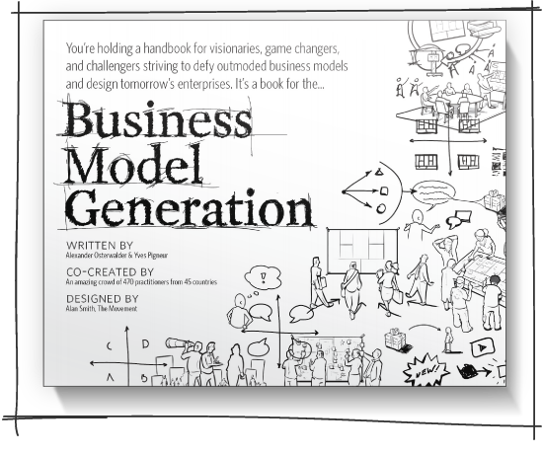
HOW WILL WE GET THERE?
ALEX OSTERWALDER
http://www.businessmodelgeneration.com/book

Slide 15
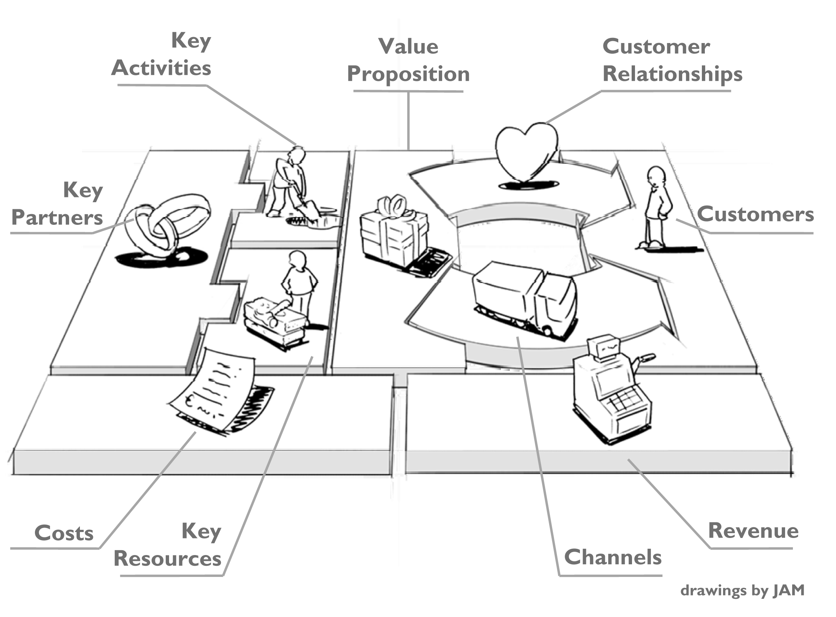
HOW WILL WE GET THERE?
in: Business Model Generation, Alex Osterwalder & Yves Pigneur, 2009

Slide 16
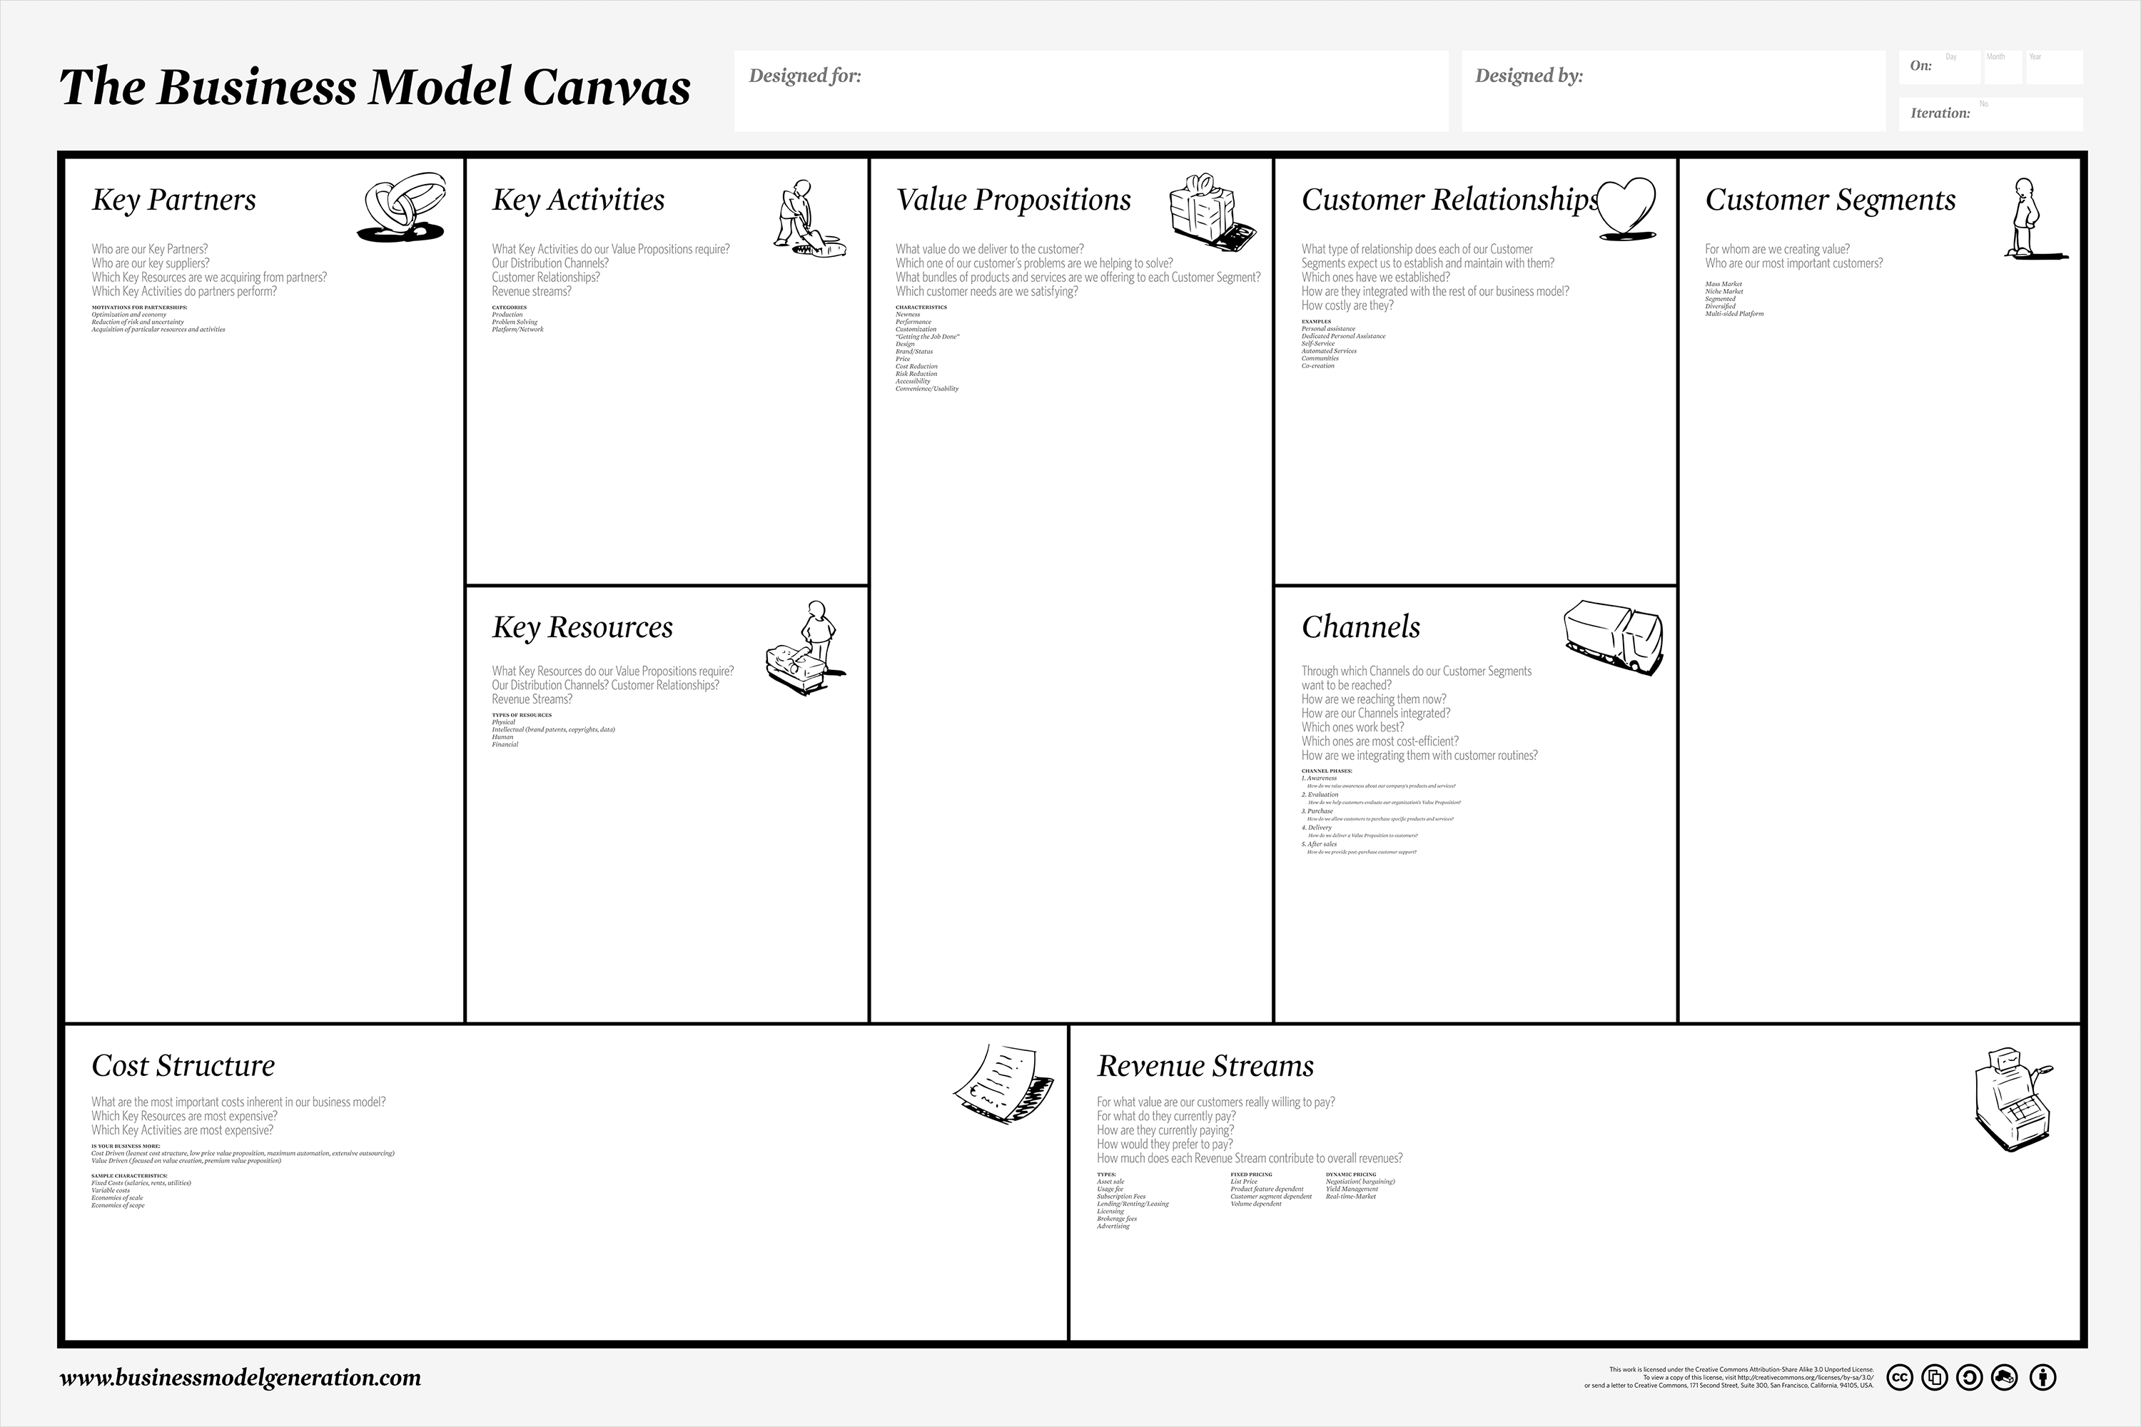
HOW WILL WE GET THERE?
in: Business Model Generation, Alex Osterwalder & Yves Pigneur, 2009

Slide 17
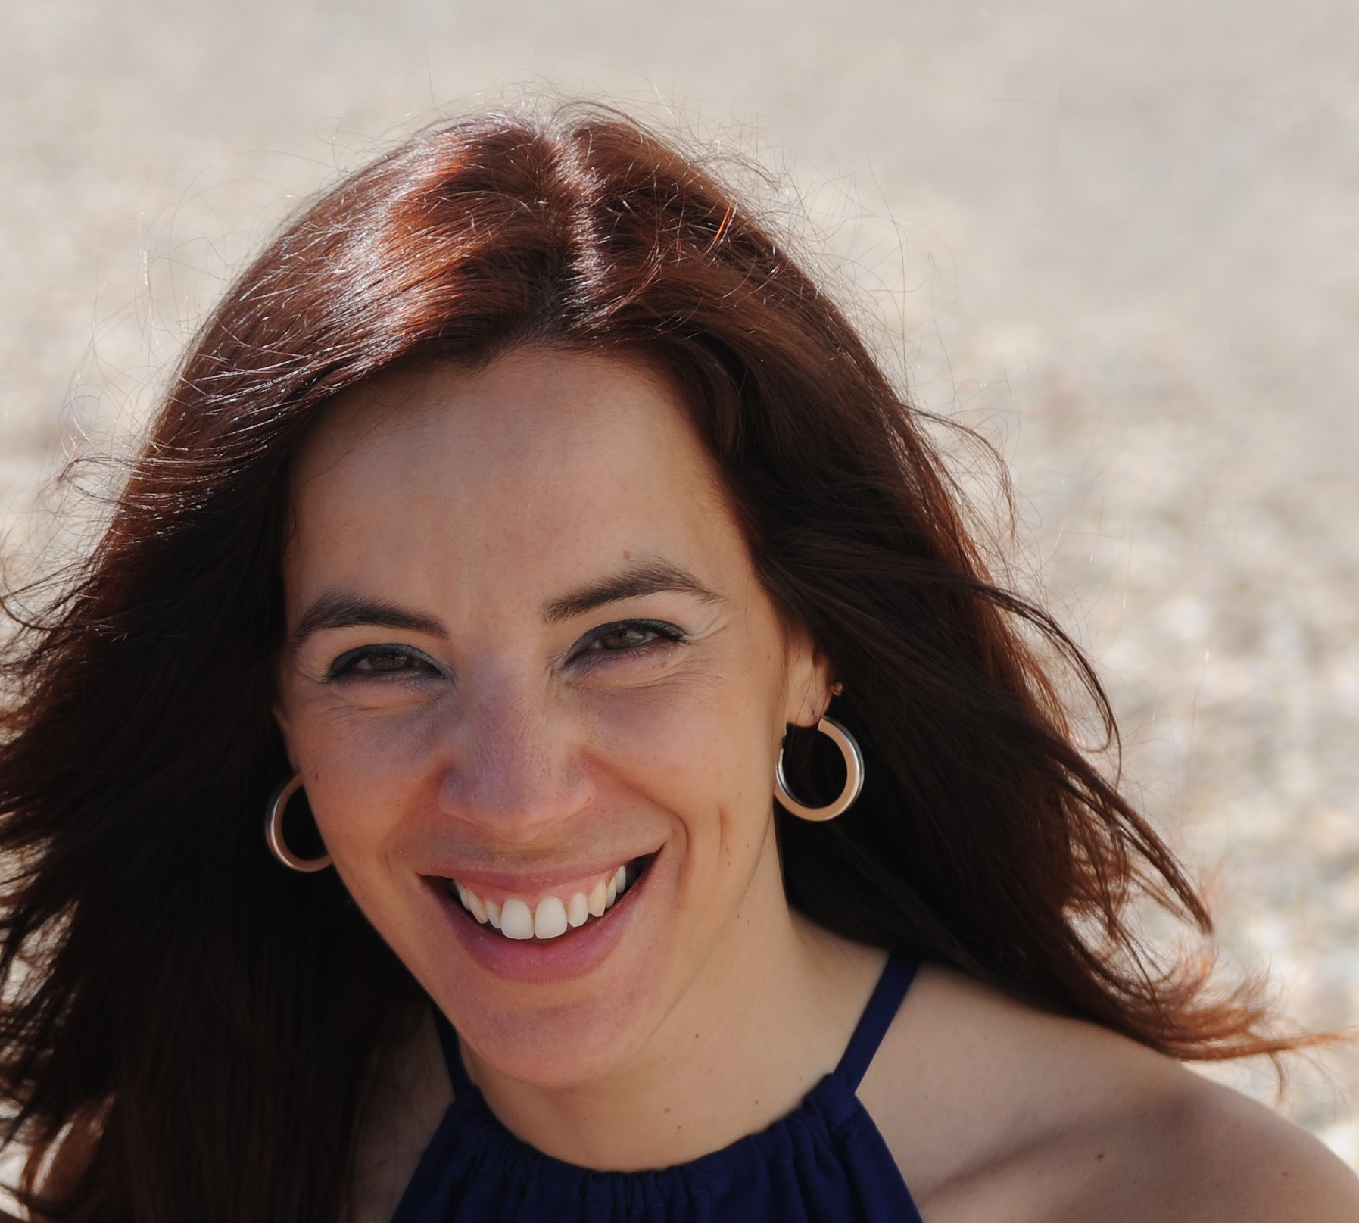
- PhD in Biomedicine in Imperial College of London, UK
University Professor for over 17 years
Lived abroad and traveled over more than 50 countries
Founder and CEO of BIOALVO SA
- Invited Professor at FCUL for Innovation & Entrepreneurship
Executive Post-Graduation in Harvard Business School
Mentor of NATIONAL NETWORK OF MENTOR
- FP7/H2020 Expert for Innovation Calls
- EU / ONU MARINE Expert
Founded MY.SKINMIX, UAU HOMES
Participated in more than 10 BP competitions and accelarators
- Executive Director of BLUEBIO ALLIANCE
WHY ME?…

Slide 18
SO, WHAT ARE YOU THINKING TO DO NEXT?
GET A JOB?
Preferably well paid!!!
Where???
How do you distinguish yourself from the rest of you in this room???

Slide 19
HOW GOOD ARE YOU?

Slide 21
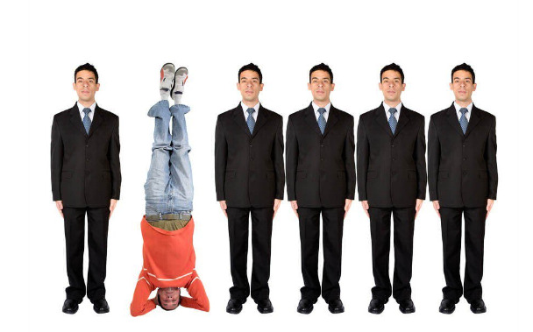

Slide 22
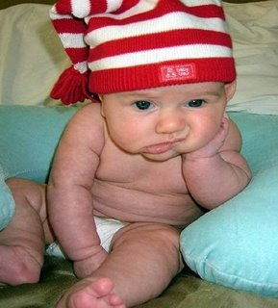
BUT I AM SORRY TO SAY….
There are no JOBS! BUT …
THERE IS A LOT OF WORK TO BE MADE!

Slide 23
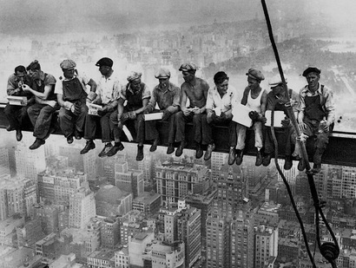
WHAT DO I DO THAT ADDS
REMARKABLE
MEASURABLE
DISTINGUISHED
DISTINCTIVE
VALUE?

Slide 24
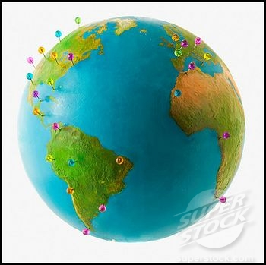
PEOPLE THAT KNOW THE WORLD BEFORE THEY “KNOW” WHAT THEY WANT!

Slide 25
IT IS NOT ABOUT YOU ALONE!!
WHAT DO YOU BRING TO YOUR EMPLOYER AND SOCIETY??!!

Slide 26
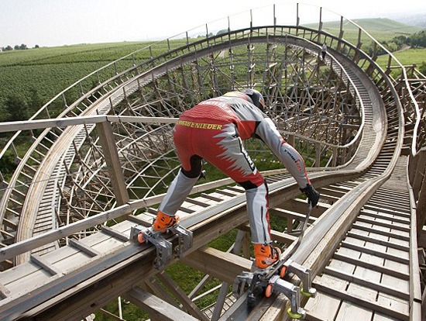
BUT YOU COULD ALSO BECOME AN ENTREPRENEUR?
WHY NOT???
Notes:
SO YOU ARE TOTALLY ARMED TO FACE THE FEAR!

Slide 27
DO YOU THINK I AM CRAZY?

Slide 28
MY CHALLENGE TO YOU!

